Slide 1

Fundamental Of C++ Programming
Fall 2016-17
Amin Paydar
Paul Deitel, Harvey Deitel-C++ How to Program-Pearson (2014)

Slide 2
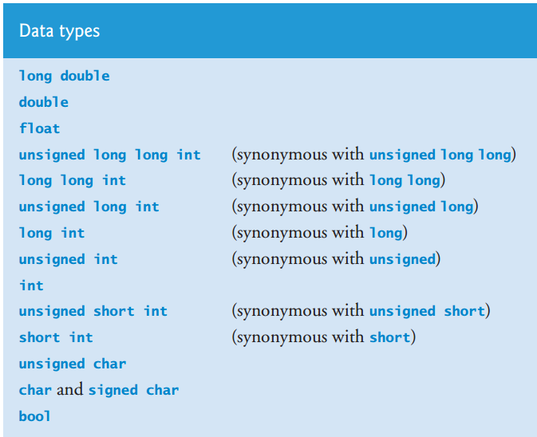
Data Types

Slide 3
Character
char c = '$';
Declaration
Convertable to integer
Ascii codes
American Standard characters
Each char has a code
int a = (int) c;
c = (char) a;

Slide 4
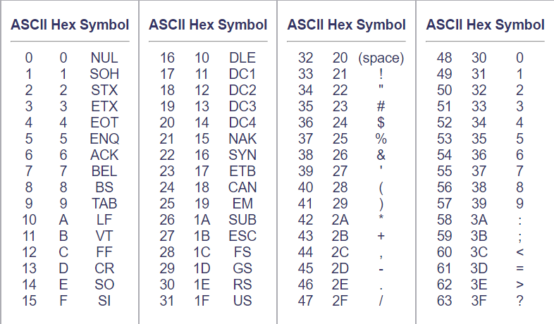
Character

Slide 5
Boolean
Has value of true or false
Convertable to int
True => 1
False => 0
Example
bool b = 5 > 7;
bool my_bool = 1000;
bool my_bool = "asdf";

Slide 6
Boolean Algebra

Slide 7
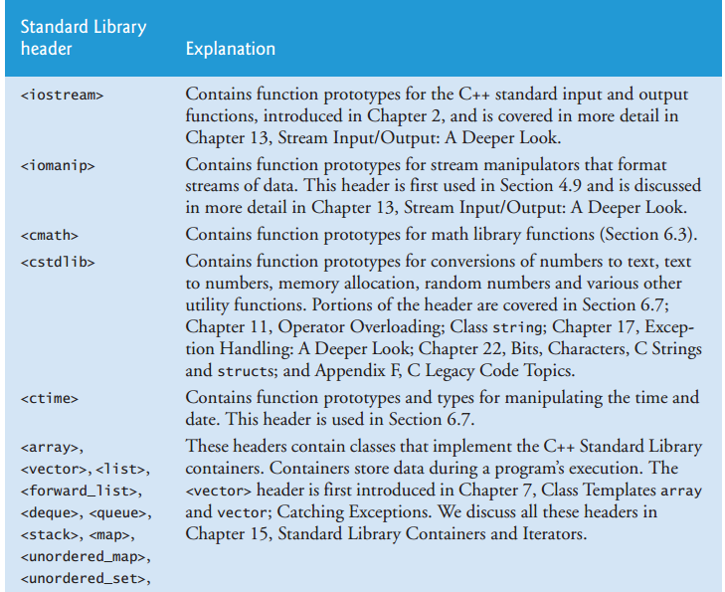
Standard Libraries

Slide 8
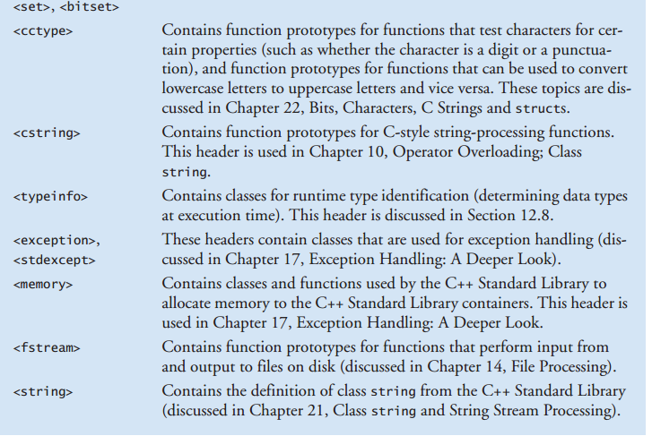
Standard Libraries

Slide 9
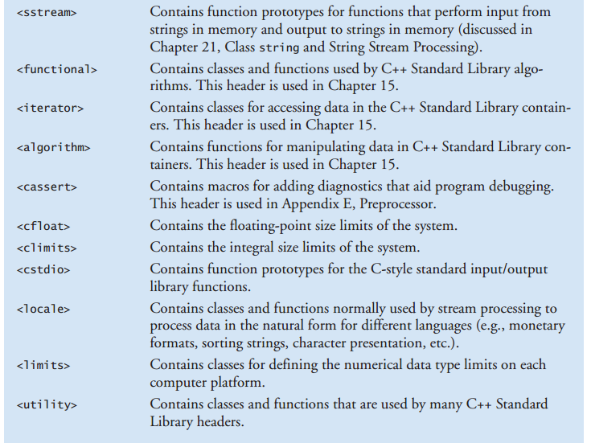
Standard Libraries

Slide 10
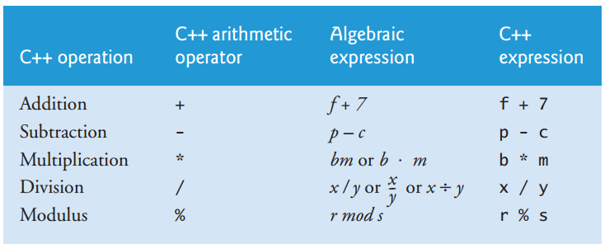
Arithmetic operators

Slide 11
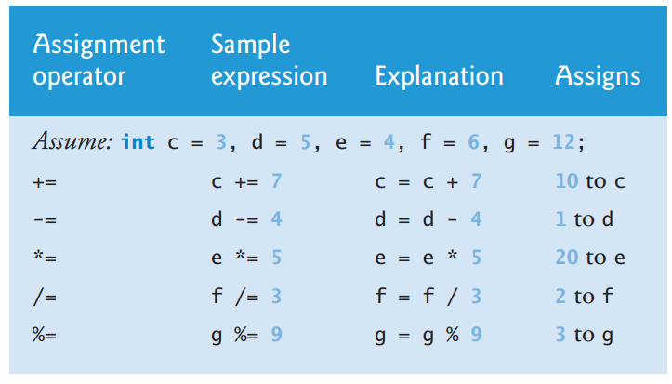
Arithmetic Assignment operators

Slide 12
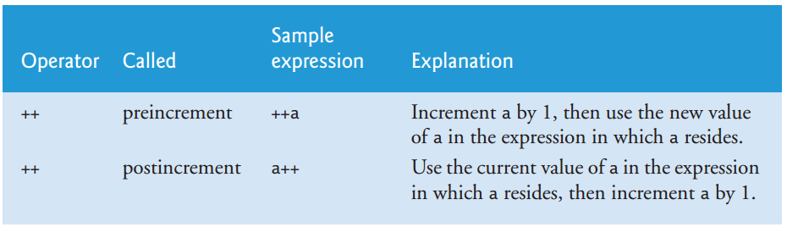
Increment and decrement Operators

Slide 13
Increment and decrement Operators
What is output ?
int a = 10;
cout << a++ << endl; // prints 10 and then increment cout << ++a << endl; // increment and then prints 12

Slide 14
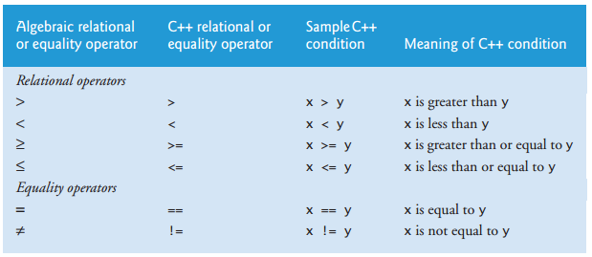
Relational operators

Slide 15
using Declarations
Next Sessions

Slide 16

Preprocessor directives
Include
Causes a copy of a specified file to be included in place of the directive.
<> used for standard library files.
“” used for both local header files and standard library files. If local file not found compiler search in standard library files.

Slide 17
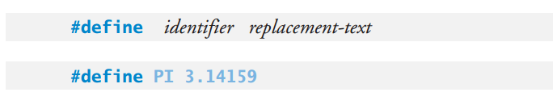
Preprocessor directives
Symbolic constants
Using meaningful names for constants
Use constants just in files that declared there

Slide 18
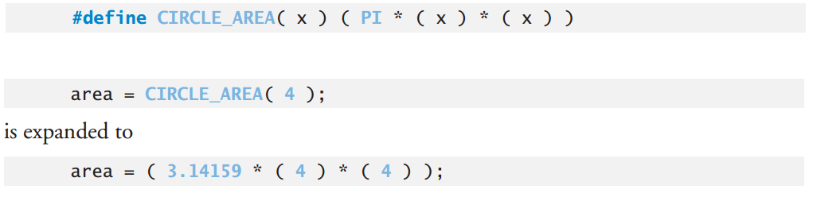
Preprocessor directives
Macros
Define functions
What difference between macros and functions ?

Slide 19
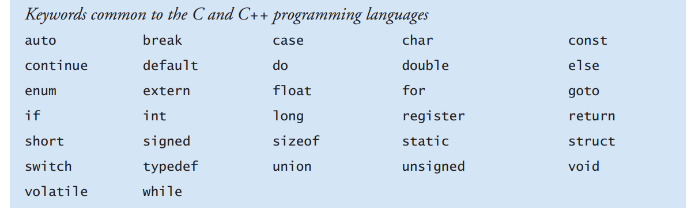
Keywords

Slide 20
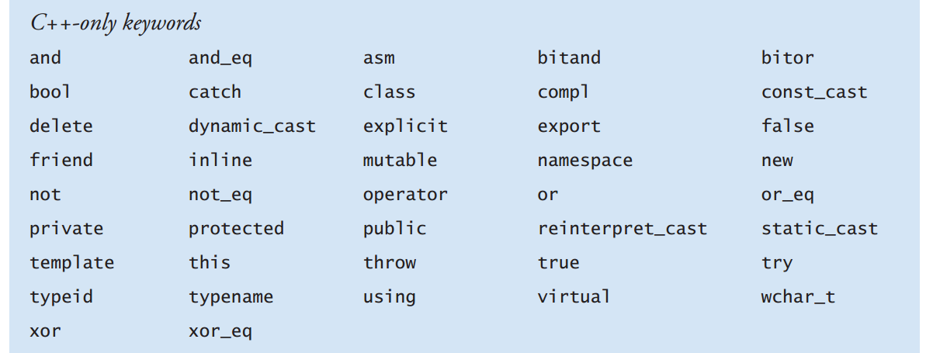
Keywords

Slide 21
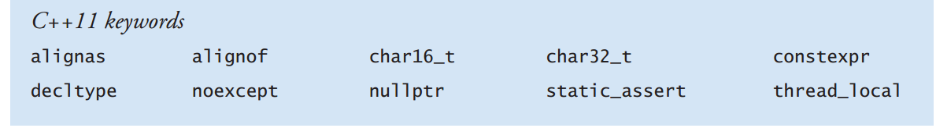
Keywords

Slide 22
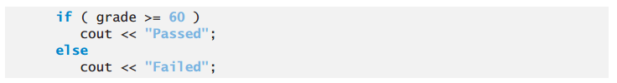
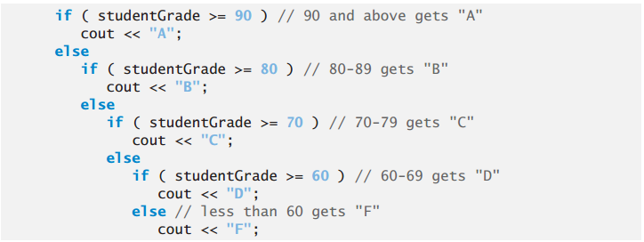
If Statement
Single if
If else
Nested if

Slide 23
If Statement
What is output ?
int grade = 10;
if (grade >= 18)
cout << "ok u are young!";
cout << "go to university";

Slide 24
Dangling-else Problem
What is output ?
int x = 10, y = 4;
if (x > 5)
if(y > 5)
cout << "x and y are > 5"; else
cout << "x is <= 5";

Slide 25
Conditional Operator (?:)
By Example
char c = (age > 18) ? 't' : 'c';
cout << "you are " << ((age > 18) ? "young" : "teenager");

Slide 26
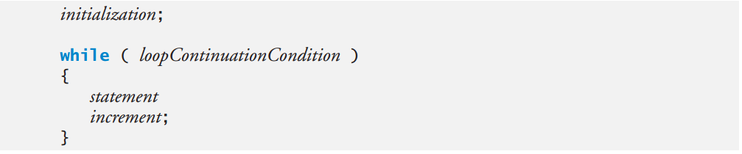
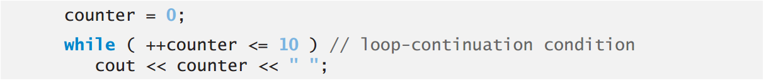
Loops
While

Slide 27
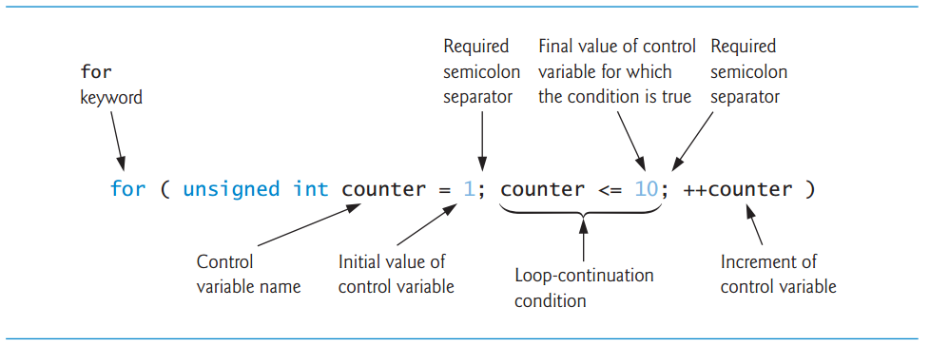
Loops
For

Slide 28
Loops
For – multi control variables
What is output ?
for (int x = 1, y = 2; x <= 9 && y <= 10; x += 2, y += 2) printf("%d, %d\n", x, y);

Slide 29
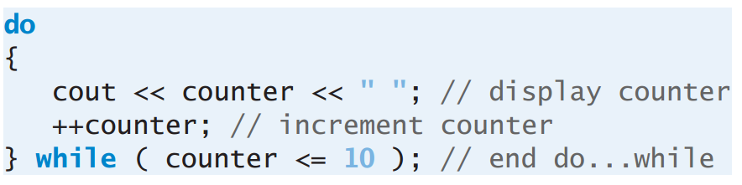
Loops
Do while

Slide 30
Nested Loops
What is output ?
for (int i = 0; i < 10; i++)
{
for (int j = 0; j < 10; j++)
{
printf("Cefiro\n");
}
}

Slide 31
Break Statement
Break; exit from loop or switch
for (int i = 0; i < 10; i++)
{
if (i == 5)
break;
cout << i << " ";
}

Slide 32
Continue Statement
Continue; skip remaining statements in current loop
for (int i = 0; i < 10; i++)
{
if (i == 5)
continue;
cout << i << " ";
}

Slide 33
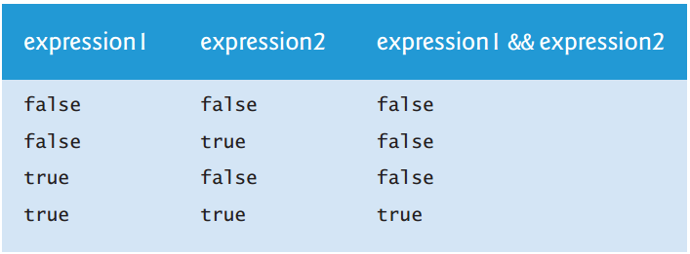
Logical Operators
AND
Example

Slide 34
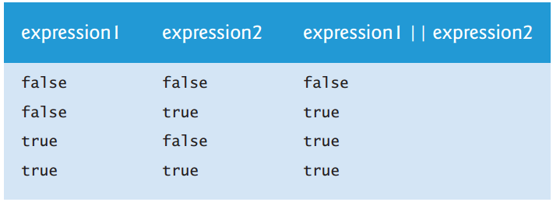
Logical Operators
OR
Example

Slide 35
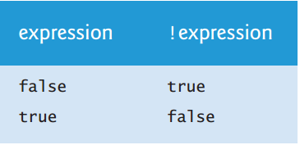
Logical Operators
NOT
Example

Slide 36
Confusing the == and =
== is equality
= is assignment
What is output?
This is not a syntax error. But be careful.

Slide 37
Built-in(fixed-size) Array
To reserve some elements of one specifics type
Declaration
array size must be a constant integer
Initializing Built-In Arrays

Slide 38
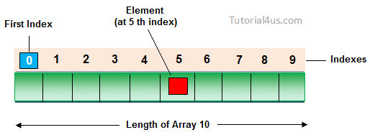
Built-in(fixed-size) Array
Index of elements start from 0 to arraysize - 1
Assign to an element of array
Read value of an element of array
double array [10];
array[0] = 10.01;
cout << array[0];

Slide 39
Built-in(fixed-size) Array
Built-in arrays have several limitations:
They cannot be compared using the relational and equality operators—you must use a loop to compare two built-in arrays element by element.
They cannot be assigned to one another
They don’t know their own size—a function that processes a built-in array typically receives both the built-in array’s name and its size as arguments.
They don’t provide automatic bounds checking—you must ensure that array-access expressions use subscripts that are within the built-in array’s bounds

Slide 40
Built-in(fixed-size) Array
Prefer to not use built-in array, instead
use pointers, array and vector class.
But some time required use built in arrays. When ?
Programs that get command arguments

Slide 41
Functions
This is better in develop large programs to construct it from small, simple pieces or components. This technique is called divide and conquer.
How to divide C++ codes to small components??
Using Functions

Slide 42
Functions
Several motivations for modularizing a program with functions :
One is the divide-and-conquer approach
Another is software reuse. For example, in earlier programs, we did not have to define how to read a line of text from the keyboard—C++ provides this capability via the getline function of the <string> header
To avoid repeating code
Also, dividing a program into meaningful functions makes the program easier to debug and maintain

Slide 43
Functions
return_type function_name( parameter1, parameter2,…)
{
body of the function
}

Slide 44
Functions
int add_2number(int a, char b)
{
int add = a + b;
return add;
}

Slide 45
Void Type
Void means nothing
In functions return nothing
void* what does it mean ?
void print (char* str)
{
cout << str << endl;
}

Slide 46
Functions
Calling Functions
int add_2number(int a, char b)
{
int add = a + b;
return add;
}
int main ()
{
int x = 2;
int y = 3;
cout << "x + y = " << add_2numbers(x,y);
}

